Slide 1
C++ Role Playing Game
Richard Came

Slide 2
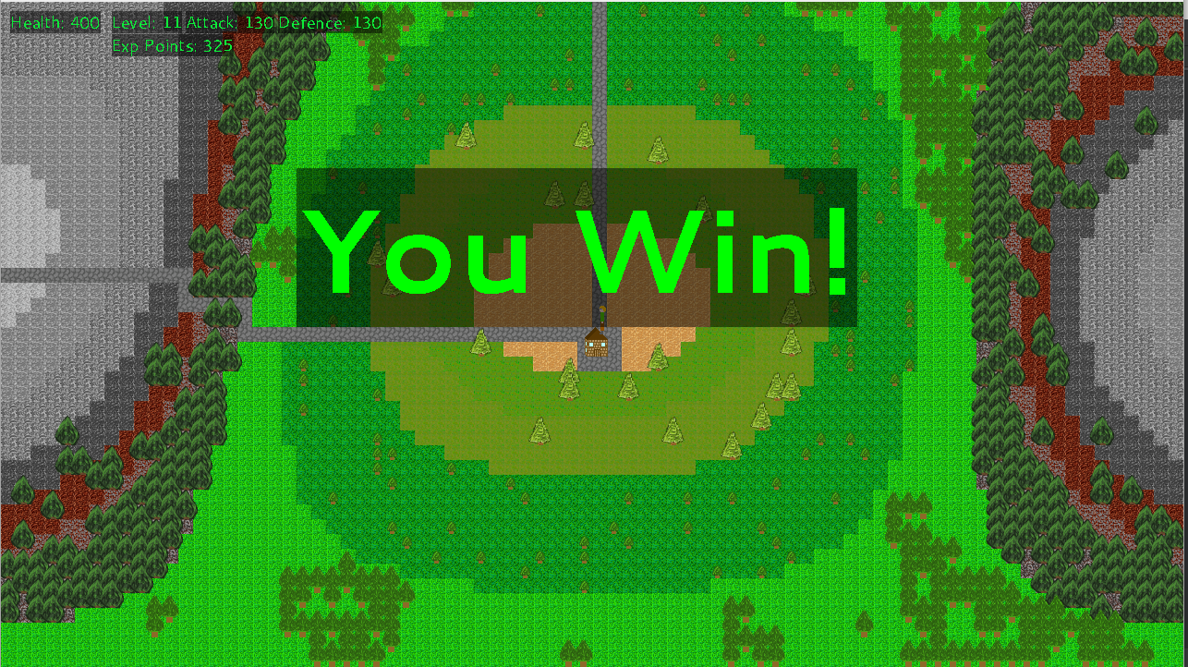
Procedurally Generated Terrain
The terrain in the game would is procedurally generated using Perlin Noise.

Slide 3
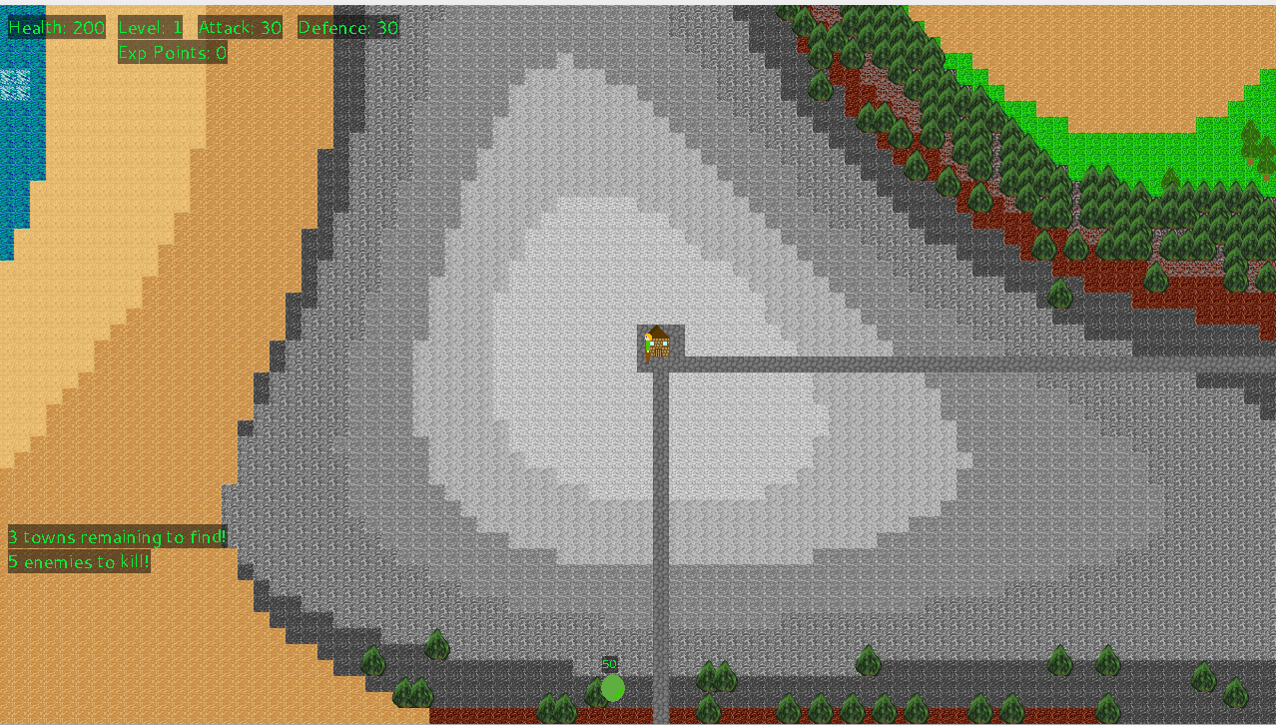
Procedurally Generated Structures and Towns
Towns are placed on the map and roads are placed between them.

Slide 4

Player Character Implementation
The player character is controlled by user input.

Slide 5


Non-Player Character AI
Enemy NPC’s have pathfinding and combat features.

Slide 6
Procedurally Generated Characters
Characters statistics are procedurally generated when they are created.

Slide 7
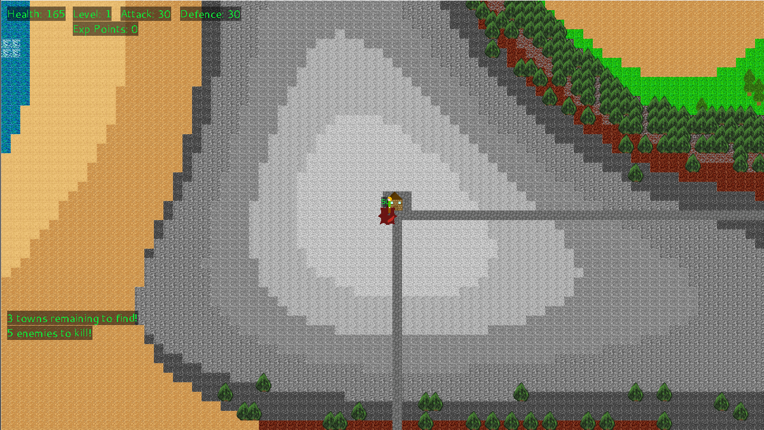
Combat Mechanics & Hit Detection
There is melee combat and hit detection implemented.

Slide 8
Levelling System
Characters each have a level and the level directly dictates their strength.

Slide 9
Procedurally Generated Quests
There is a quest system in the game that gives the player pre-created quests.

Slide 10
Methodology & Project Planning
Agile Methodology was used as the base however flexibility was employed on the sprint plan in order to better prioritise work as the game evolved.

